Slide 1
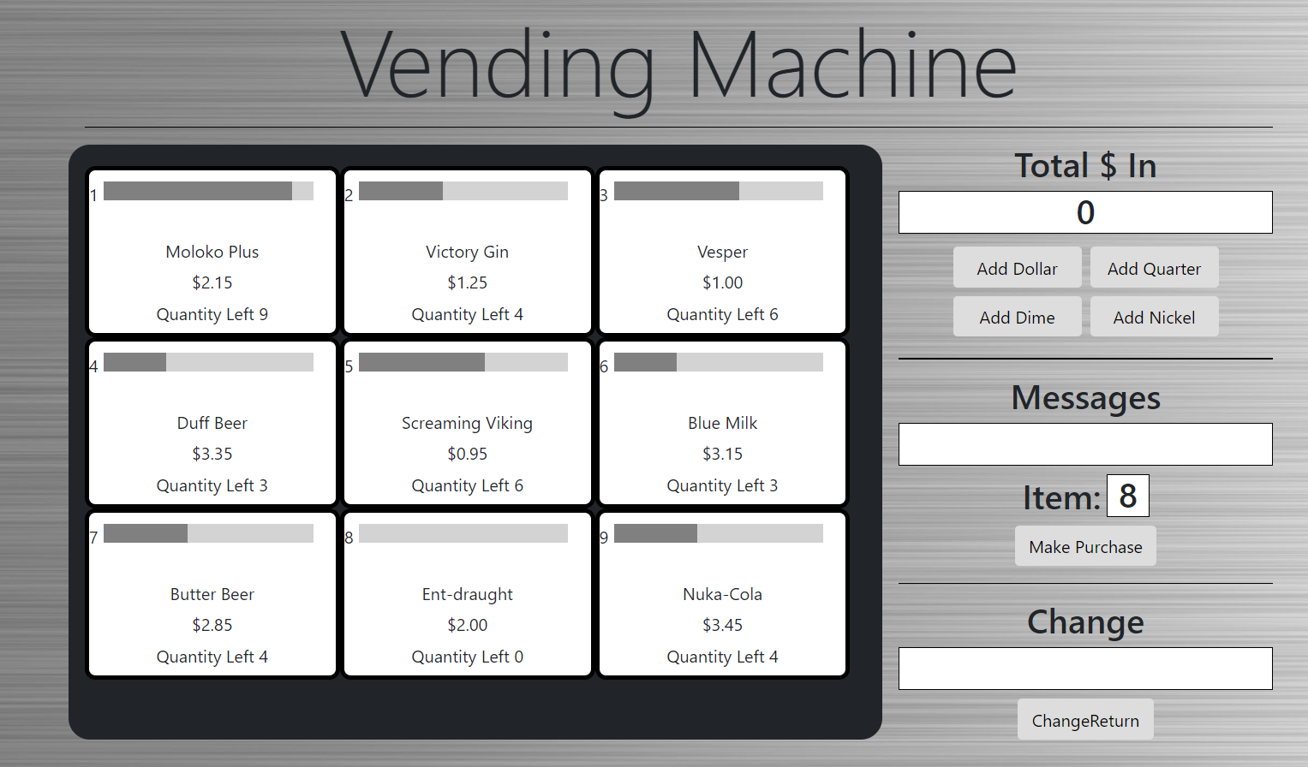

Slide 2

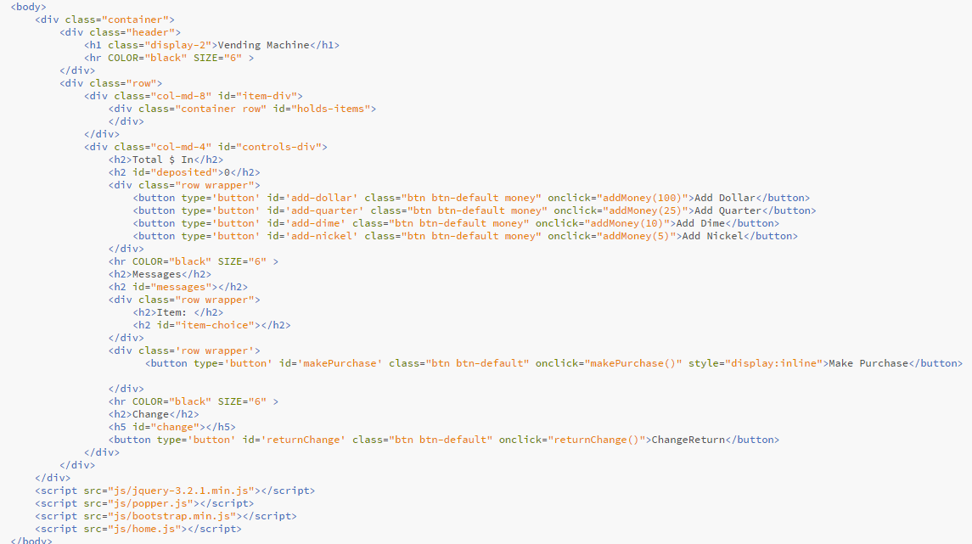
HTML

Slide 3
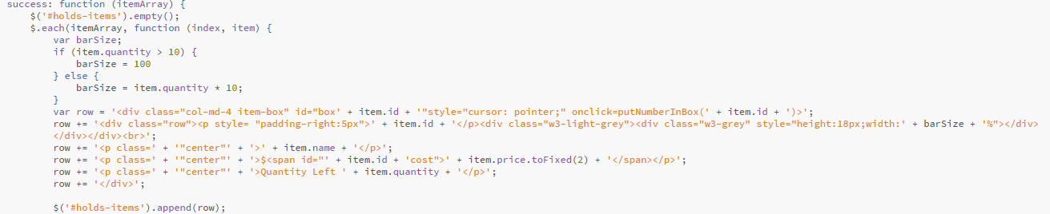
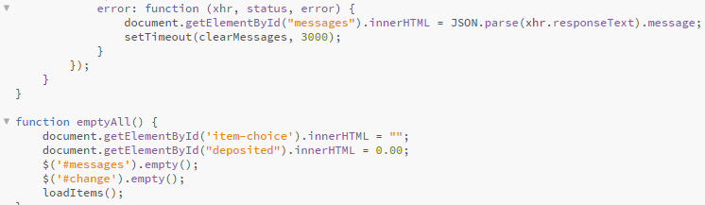
JavaScript
loadItems
end of makePurchase

Slide 4
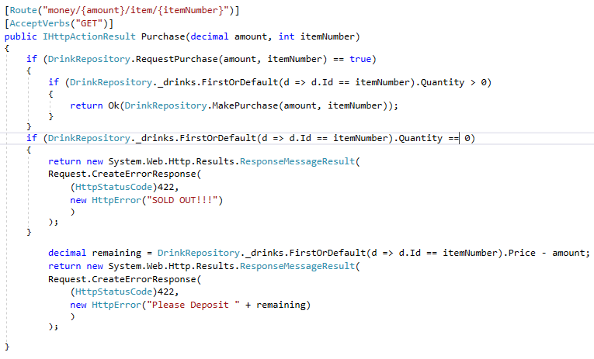
API
If enough money and stock, run methods to take one of stock and return change object.
If not enough stock… totally copied what needed to be done to send the error from Stack
If not enough money return 422 with error message including amount short.

